Slide 1
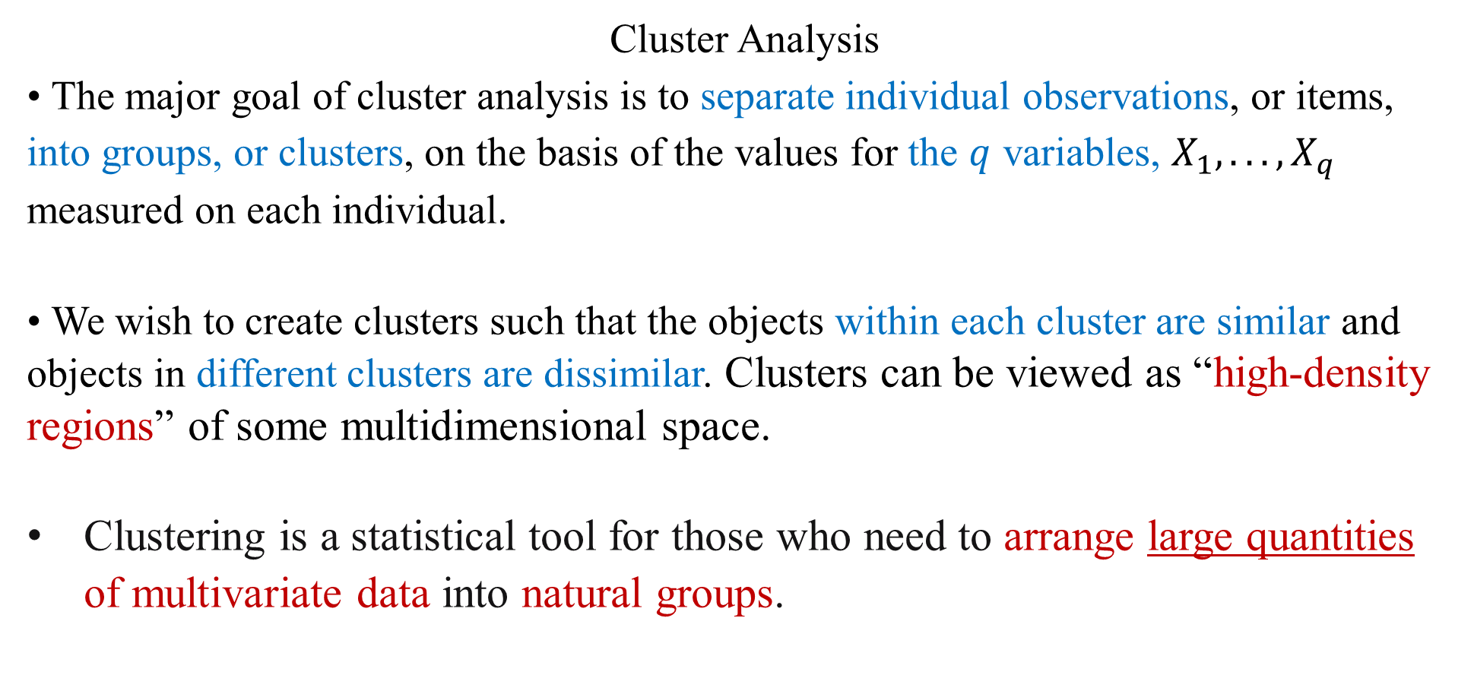
Cluster Analysis
• The major goal of cluster analysis is to separate individual observations, or items, into groups, or clusters, on the basis of the values for the $q$ variables, $X_{1}, . . . , X_{q}$ measured on each individual.
• We wish to create clusters such that the objects within each cluster are similar and objects in different clusters are dissimilar. Clusters can be viewed as “high-density regions” of some multidimensional space.
Clustering is a statistical tool for those who need to arrange large quantities of multivariate data into natural groups.

Slide 2
Applications of Cluster Analysis
• Find customer groups to adjust advertisement :
In marketing, researchers use demographic and consumer profiles in an attempt to segment the marketplace into small, homogeneous groups so that several distinct marketing strategies can be used more efficiently for the clusters.
In ecology, scientists classify plants or animals into various groups based on some measurable characteristics.
• Researchers in genetics may separate genes into several classes based on their expression ratios measured at different time points.
In medical research, doctors want to find subtypes of diseases to fine-tune treatment

Slide 3
Cluster Analysis
• The dissimilarity between any two objects is typically quantified using a distance measure (like Euclidean distance, manhattan, simple matching coefficient, etc).
• Cluster analysis is a type of unsupervised classification for analyzing unstructured multivariate data, because we do not know the nature of the groups (or the number of groups, typically) before we classify the objects into clusters.
Within the data-mining community, cluster analysis is also known as data segmentation, and within the machine-learning community, it is also known as class discovery.

Slide 4
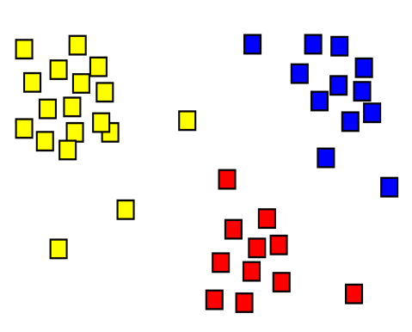
Clustering is useful in 3+ dimensions
• Human eye is extremely good at clustering
Use clustering only, if you can not look at the data (i.e. more than 2 dimensions)

Slide 5
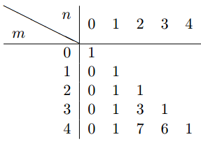
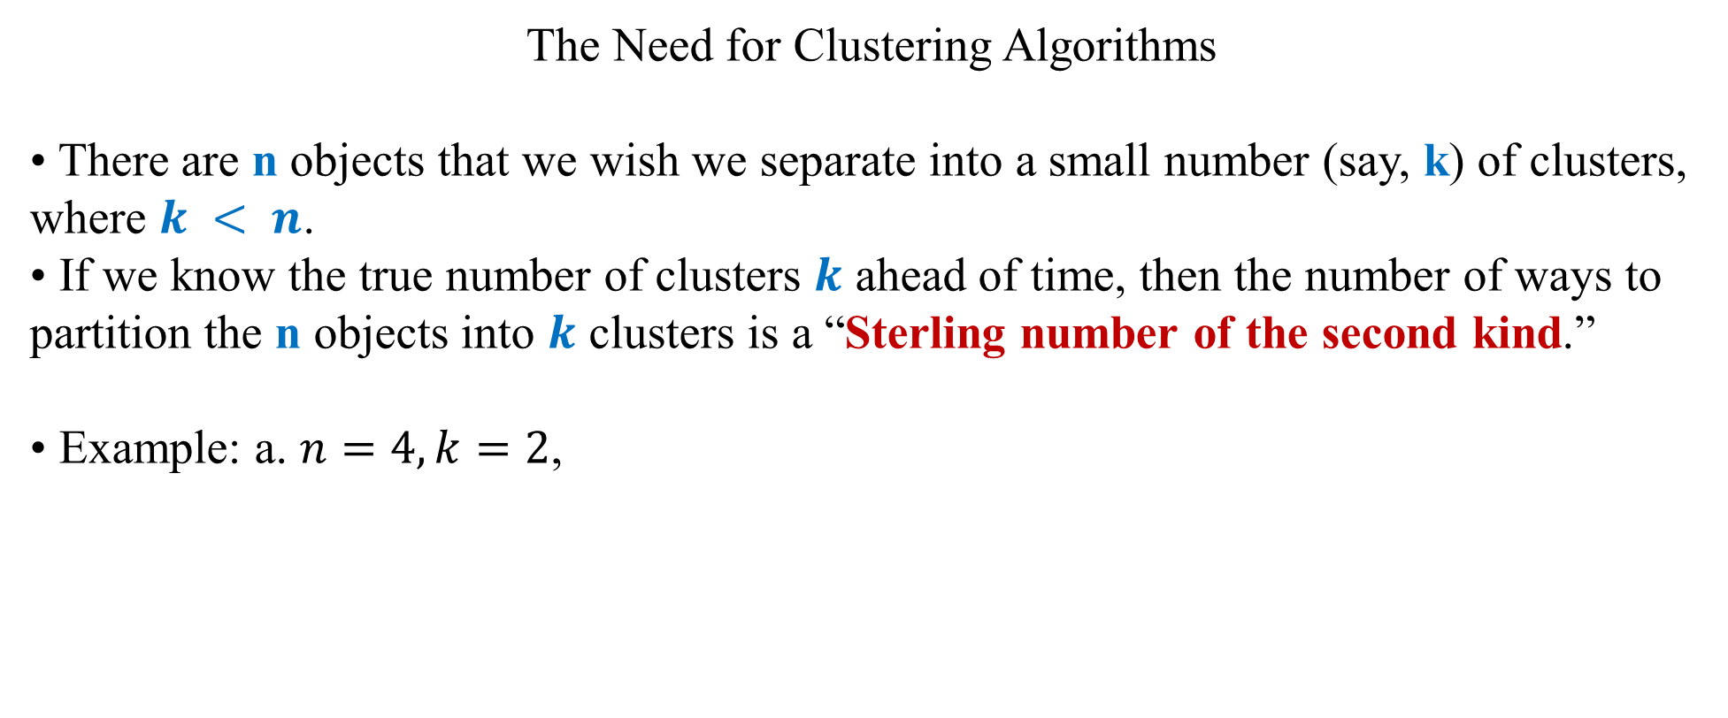
The Need for Clustering Algorithms
• There are n objects that we wish we separate into a small number (say, k) of clusters, where $k < n$.
• If we know the true number of clusters $k$ ahead of time, then the number of ways to partition the n objects into $k$ clusters is a “Sterling number of the second kind.”
• Example: a. $n=4, k=2$,

Slide 6
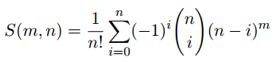
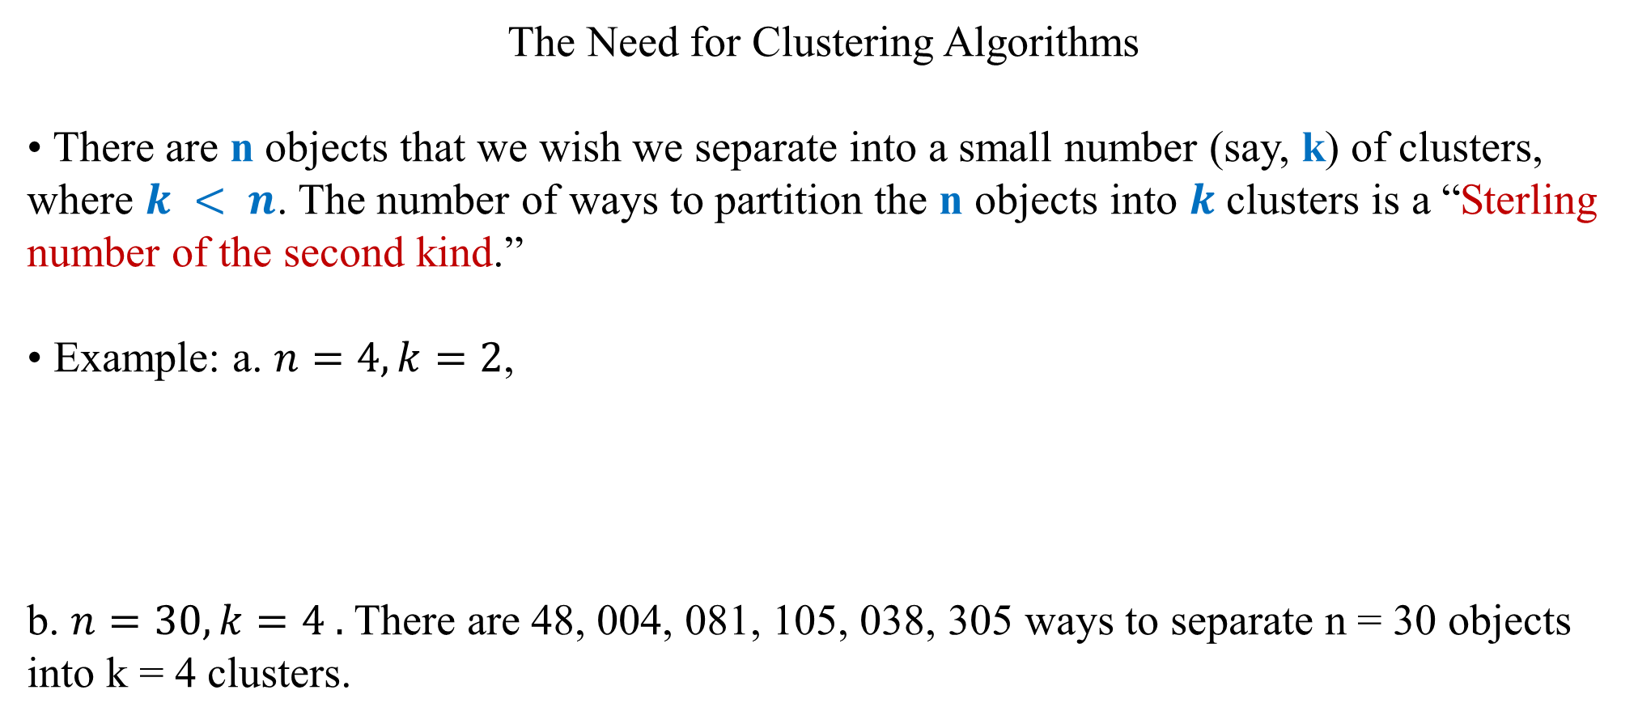
The Need for Clustering Algorithms
• There are n objects that we wish we separate into a small number (say, k) of clusters, where $k < n$. The number of ways to partition the n objects into $k$ clusters is a “Sterling number of the second kind.”
• Example: a. $n=4, k=2$,
b. $n=30, k=4 .$There are 48, 004, 081, 105, 038, 305 ways to separate n = 30 objects into k = 4 clusters.
k
m
n

Slide 7
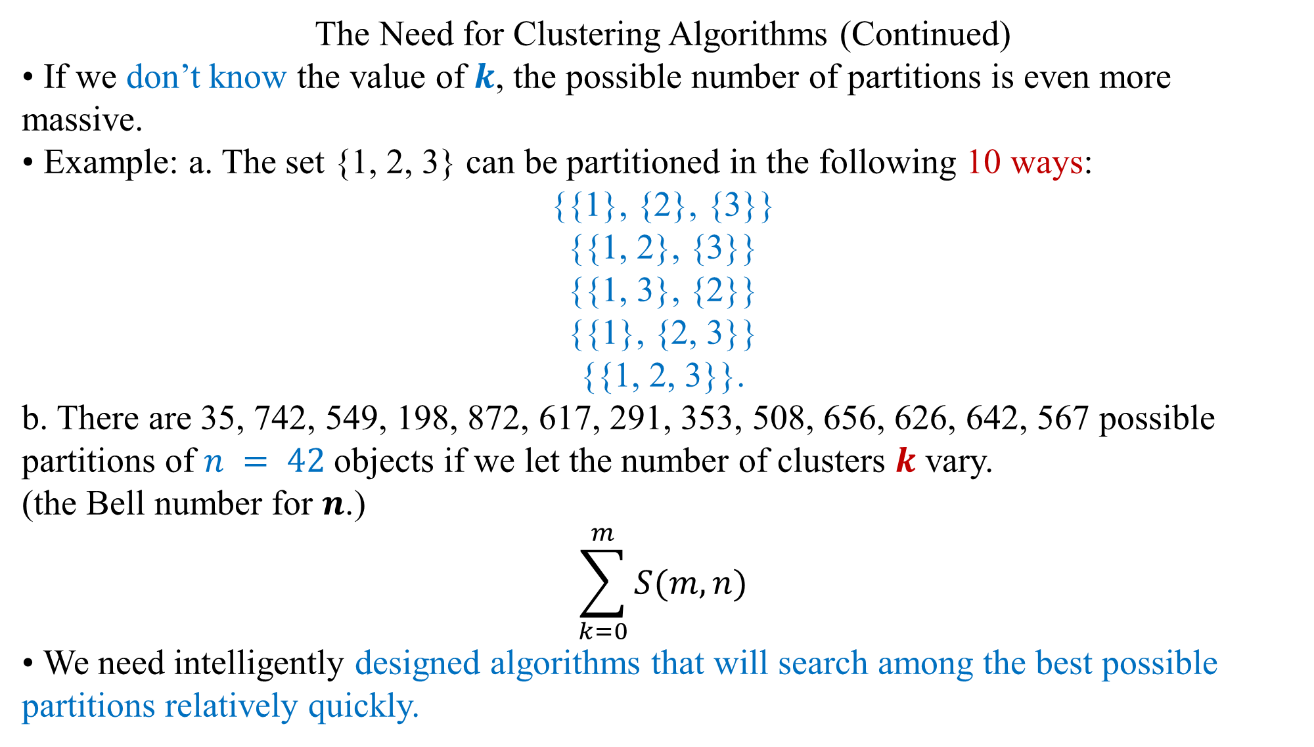
The Need for Clustering Algorithms (Continued)
• If we don’t know the value of $k$, the possible number of partitions is even more massive.
• Example: a. The set {1, 2, 3} can be partitioned in the following 10 ways:
{{1}, {2}, {3}}
{{1, 2}, {3}}
{{1, 3}, {2}}
{{1}, {2, 3}}
{{1, 2, 3}}.
b. There are 35, 742, 549, 198, 872, 617, 291, 353, 508, 656, 626, 642, 567 possible partitions of $n = 42$objects if we let the number of clusters $k$ vary.
(the Bell number for $n$.)
$$\sum_{k=0}^{m}{S(m, n)}$$
• We need intelligently designed algorithms that will search among the best possible partitions relatively quickly.

Slide 8
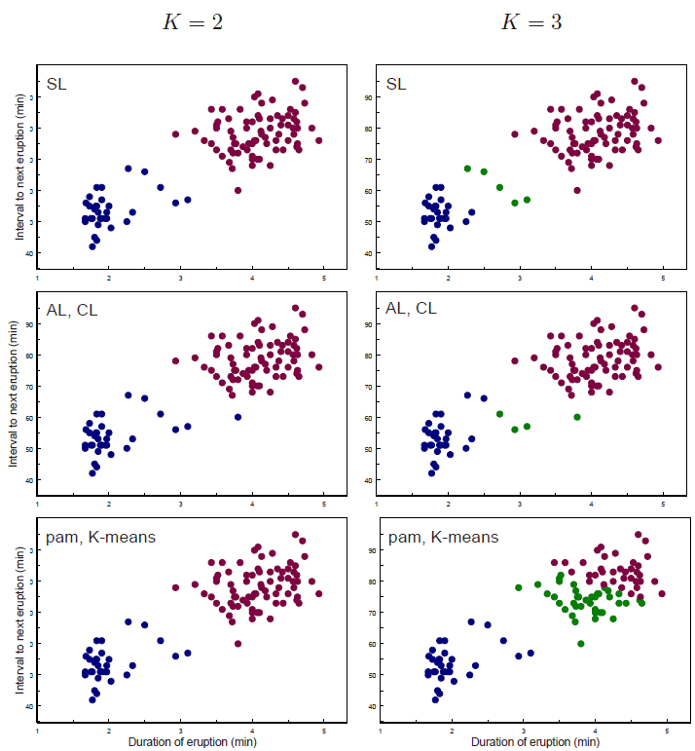
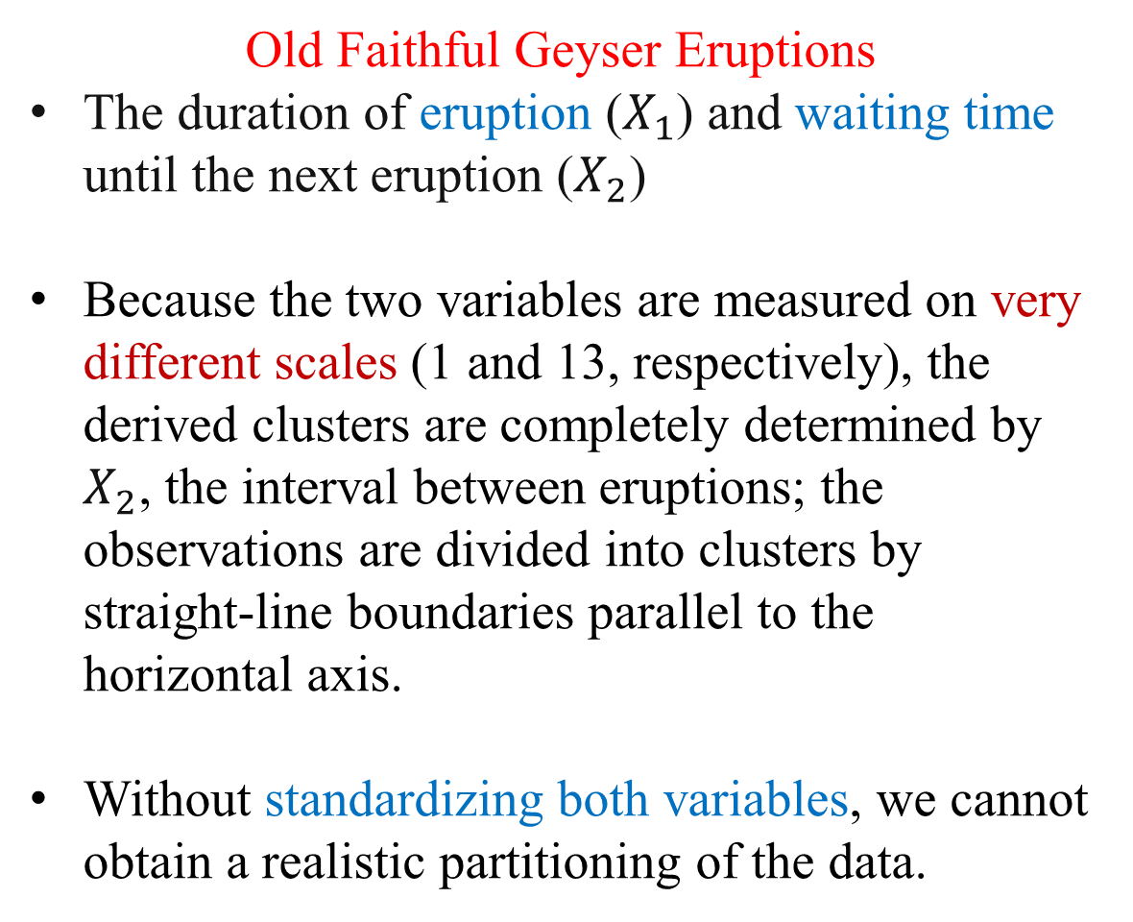
Standardized data are needed
Old Faithful Geyser Eruptions
The duration of eruption ($X_{1}$) and waiting time until the next eruption ($X_{2}$)
Because the two variables are measured on very different scales (1 and 13, respectively), the derived clusters are completely determined by $X_{2}$, the interval between eruptions; the observations are divided into clusters by straight-line boundaries parallel to the horizontal axis.
Without standardizing both variables, we cannot obtain a realistic partitioning of the data.

Slide 9
Standardization of Observations
• Possible standardization approaches:
1. Divide each column by its sample standard deviation, so that all variables have standard deviation 1.
2. Divide each variable by its sample range (max − min); Milligan and Cooper (1988) found that this approach best preserved the clustering structure.
3. Convert data to z-scores by (for each variable) – a common option in clustering software packages.

Slide 10
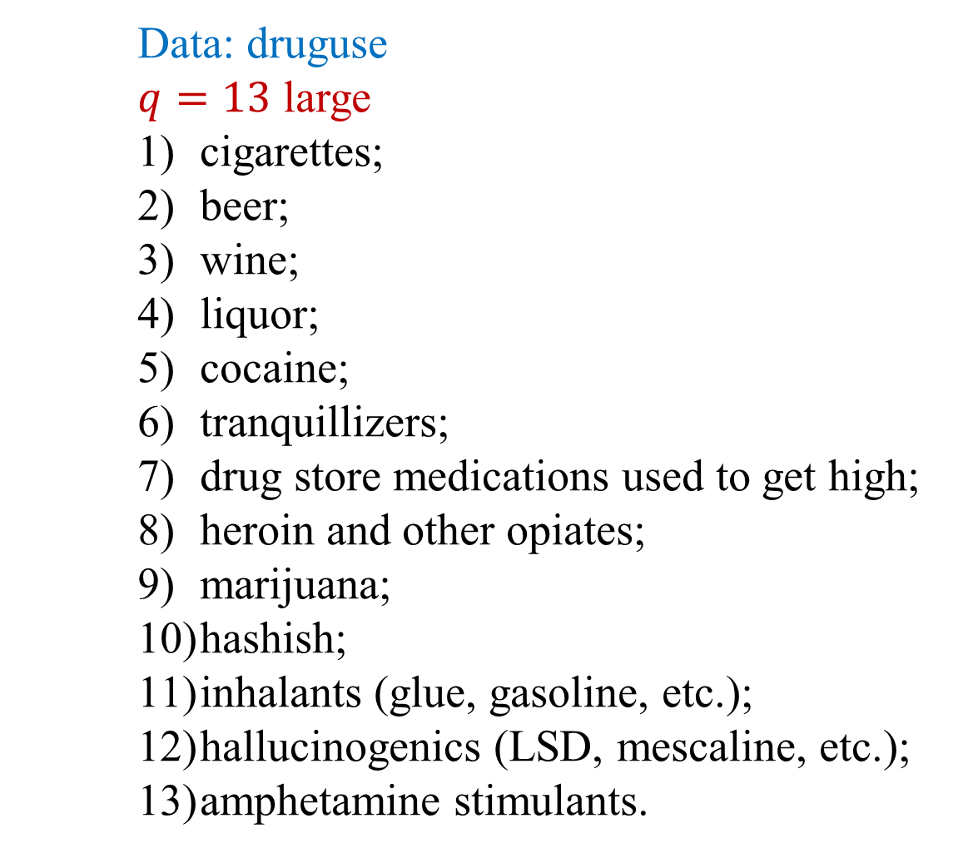
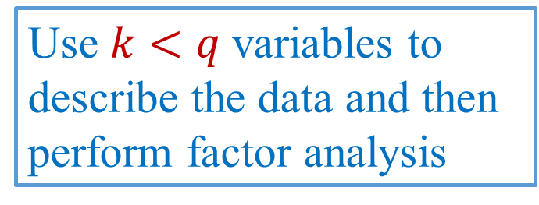
The examination of data based on the first few PC scores
Data: druguse
$q=13$ large
cigarettes;
beer;
wine;
liquor;
cocaine;
tranquillizers;
drug store medications used to get high;
heroin and other opiates;
marijuana;
hashish;
inhalants (glue, gasoline, etc.);
hallucinogenics (LSD, mescaline, etc.);
amphetamine stimulants.
Use $k<q$variables to describe the data and then perform factor analysis
Principal Component Analysis

Slide 11
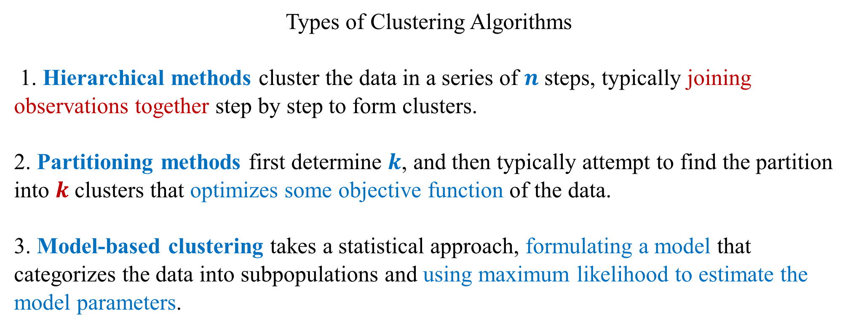
Types of Clustering Algorithms
1. Hierarchical methods cluster the data in a series of $n$ steps, typically joining observations together step by step to form clusters.
2. Partitioning methods first determine $k$, and then typically attempt to find the partition into $k$ clusters that optimizes some objective function of the data.
3. Model-based clustering takes a statistical approach, formulating a model that categorizes the data into subpopulations and using maximum likelihood to estimate the model parameters.

Slide 12
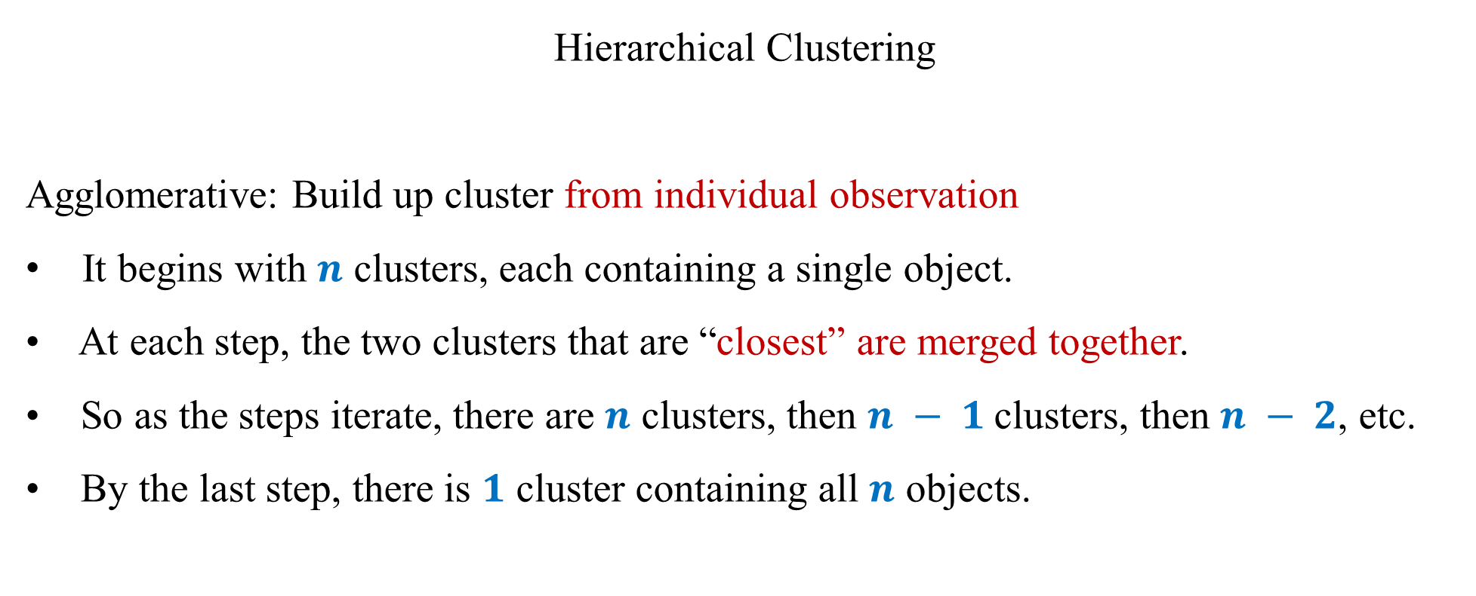
Hierarchical Clustering
Agglomerative: Build up cluster from individual observation
It begins with $n$ clusters, each containing a single object.
• At each step, the two clusters that are “closest” are merged together.
• So as the steps iterate, there are $n$ clusters, then $n − 1$clusters, then $n − 2$, etc.
• By the last step, there is $1$ cluster containing all $n$ objects.

Slide 13
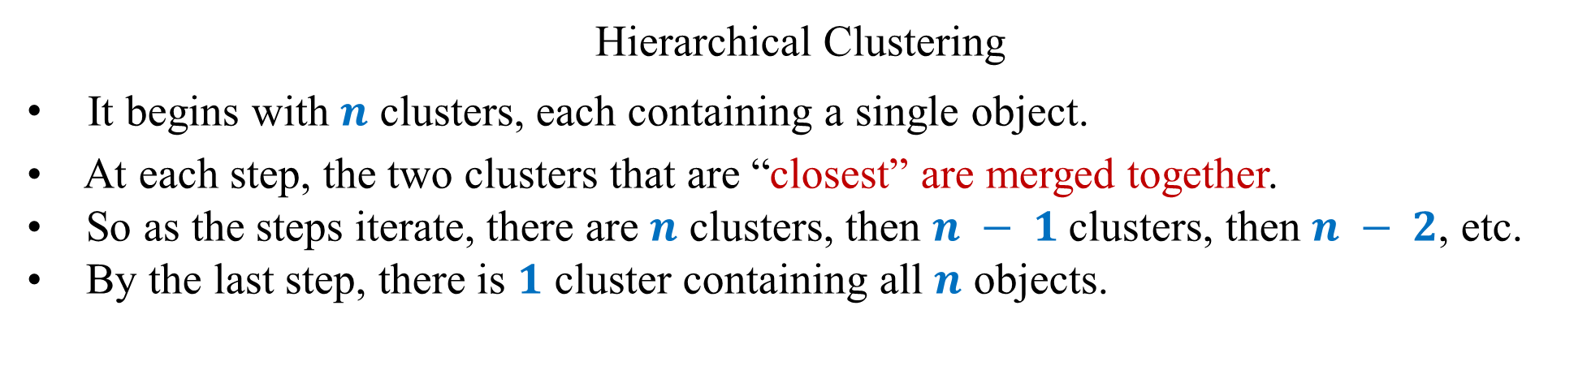
Hierarchical Clustering
It begins with $n$ clusters, each containing a single object.
• At each step, the two clusters that are “closest” are merged together.
• So as the steps iterate, there are $n$ clusters, then $n − 1$clusters, then $n − 2$, etc.
• By the last step, there is $1$ cluster containing all $n$ objects.
Data in 2-D
Data in 2-D
Data in 2-D
Data in 2-D
b
b
b
b
a
a
a
a
c
c
c
c
e
e
e
e
d
d
d
d

Slide 14

Agglomerative
Data in 2 dimensions
Data in 2 dimensions
Data in 2 dimensions
Data in 2 dimensions
b
b
b
b
a
a
a
a
c
c
c
c
e
e
e
e
d
d
d
d

Slide 15
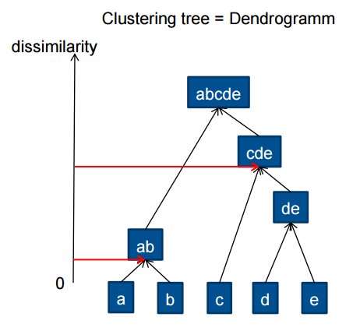
Agglomerative Clustering
Data in 2 dimensions
b
a
c
e
d

Slide 16
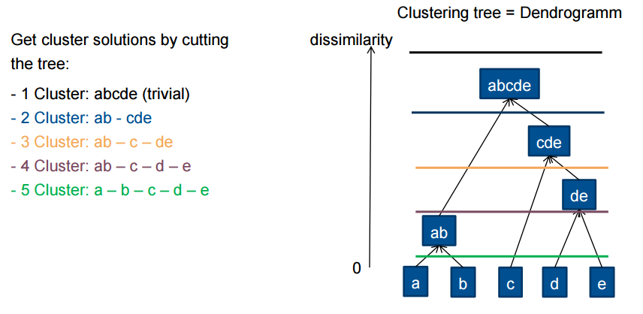
Agglomerative Clustering: Cutting the tree
Data in 2 dimensions
b
a
c
e
d

Slide 17
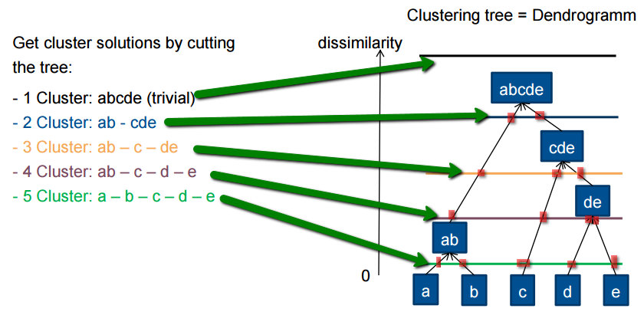
Agglomerative Clustering: Cutting the tree
Data in 2 dimensions
b
a
c
e
d

Slide 18
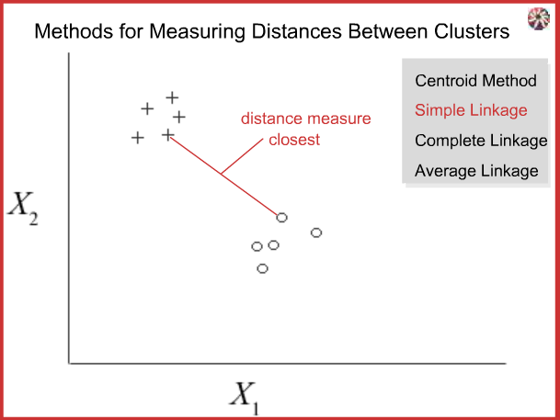
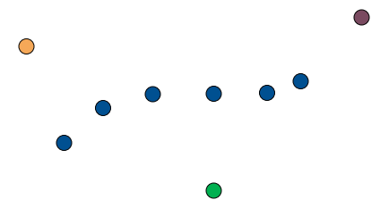
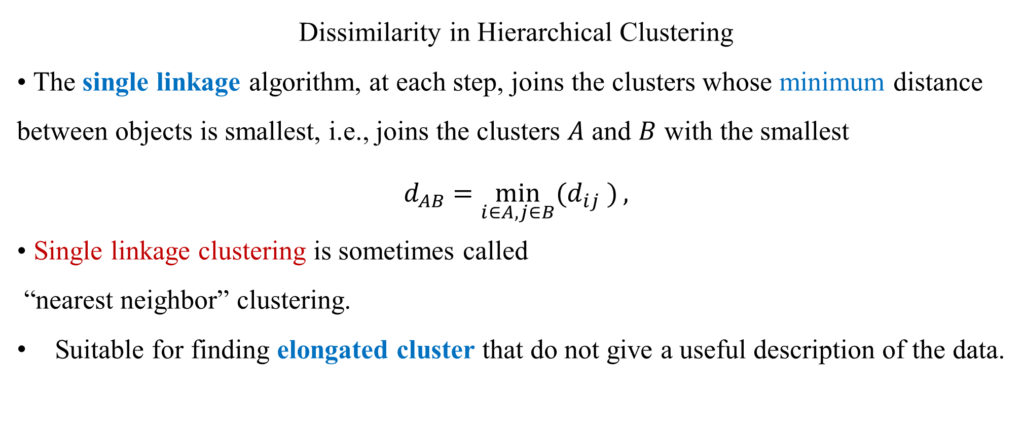
Dissimilarity in Hierarchical Clustering
• The single linkage algorithm, at each step, joins the clusters whose minimum distance between objects is smallest, i.e., joins the clusters $A$ and $B$ with the smallest
$${ d}_{AB} =\min_{i∈A,j∈B}{(d_{ij} )},$$
• Single linkage clustering is sometimes called
“nearest neighbor” clustering.
Suitable for finding elongated cluster that do not give a useful description of the data.

Slide 19
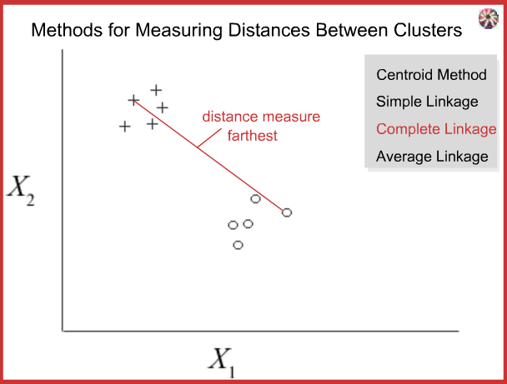
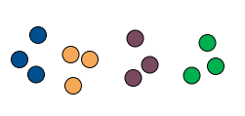
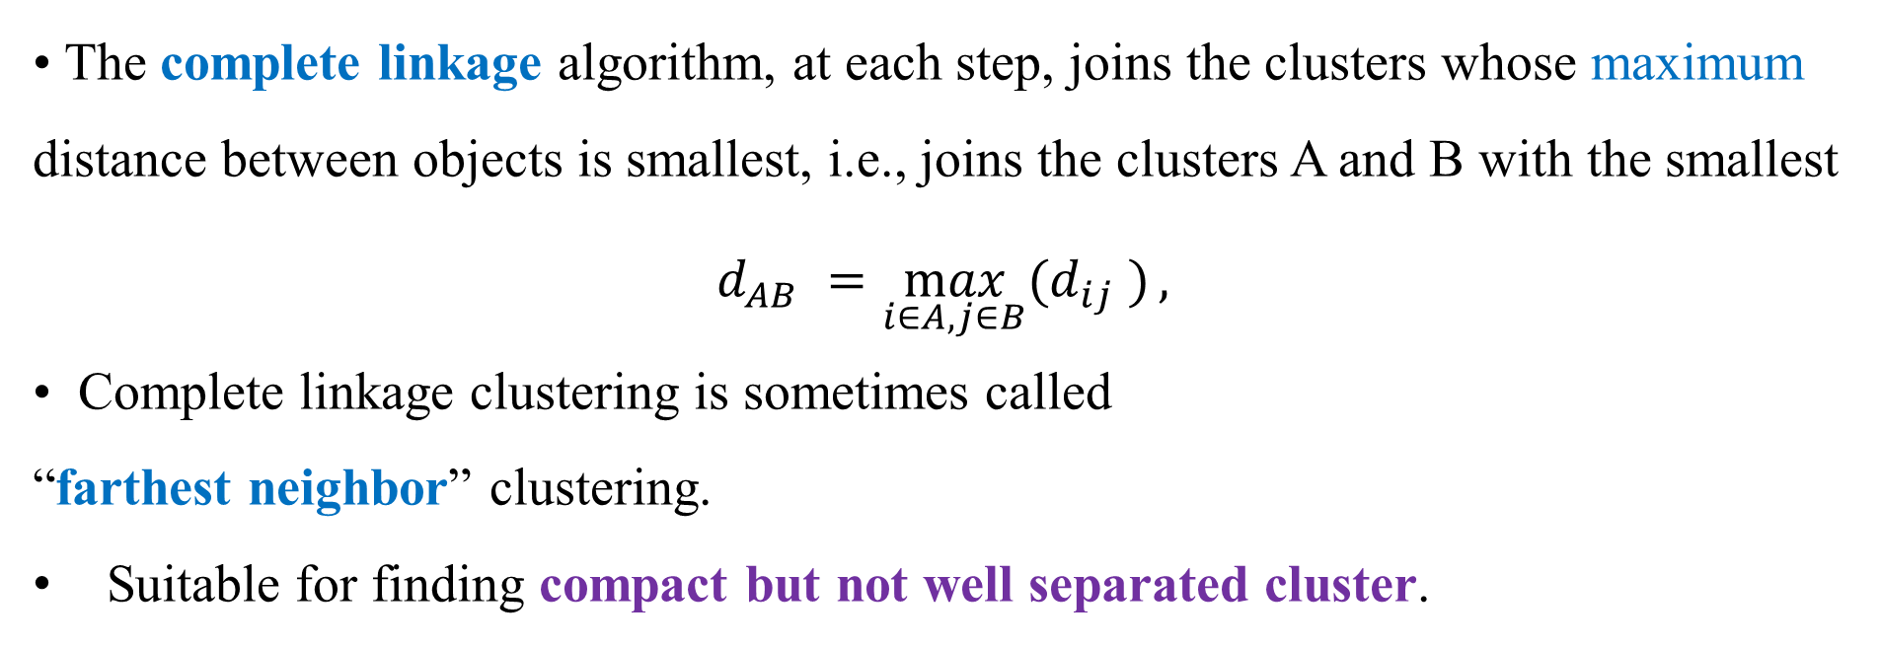
• The complete linkage algorithm, at each step, joins the clusters whose maximum distance between objects is smallest, i.e., joins the clusters A and B with the smallest
$$d_{AB} =\max_{i∈A,j∈B}{(d_{ij} )},$$
• Complete linkage clustering is sometimes called
“farthest neighbor” clustering.
Suitable for finding compact but not well separated cluster.

Slide 20
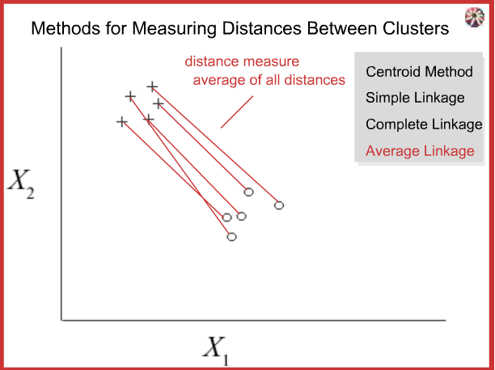
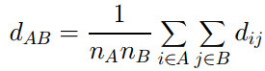
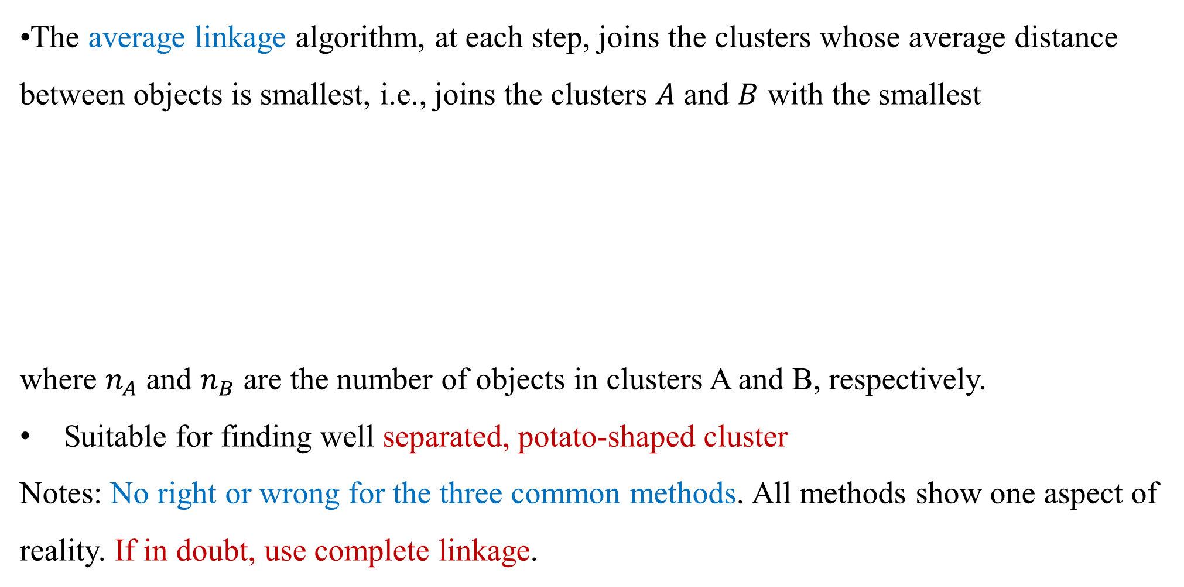
•The average linkage algorithm, at each step, joins the clusters whose average distance between objects is smallest, i.e., joins the clusters $A$ and $B$ with the smallest
where $n_{A}$ and $n_{B}$ are the number of objects in clusters A and B, respectively.
Suitable for finding well separated, potato-shaped cluster
Notes: No right or wrong for the three common methods. All methods show one aspect of reality. If in doubt, use complete linkage.

Slide 21
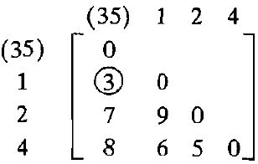
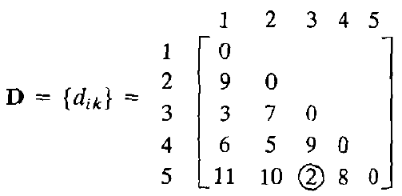
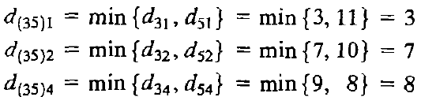
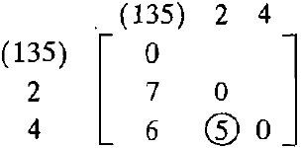
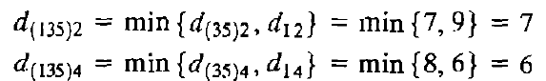
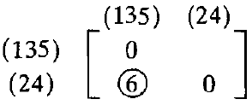
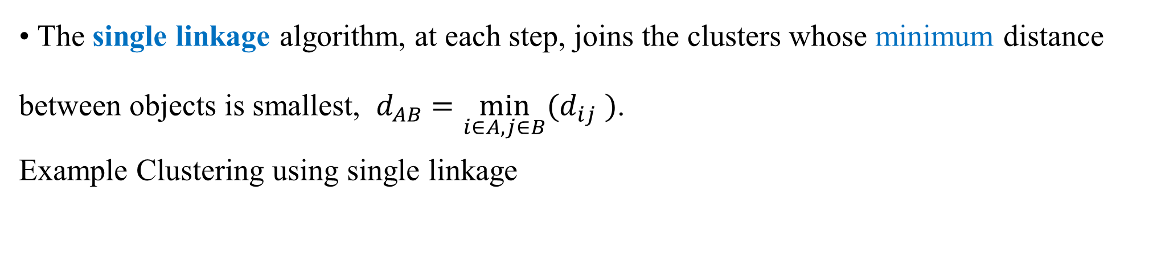
• The single linkage algorithm, at each step, joins the clusters whose minimum distance between objects is smallest, ${ d}_{AB} =\min_{i∈A,j∈B}{(d_{ij} )}$.
Example Clustering using single linkage

Slide 22
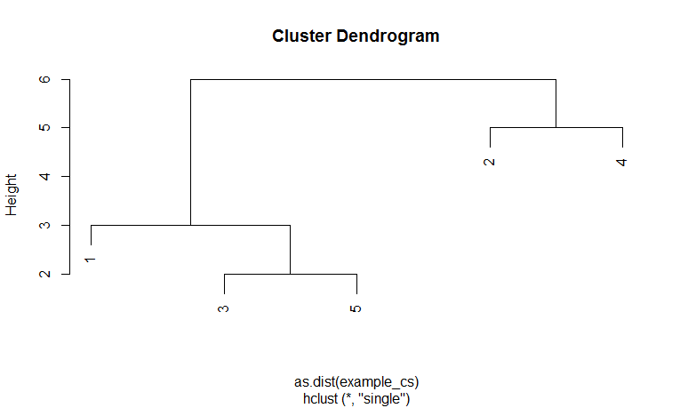
• The single linkage: ${ d}_{AB} =\min_{i∈A,j∈B}{(d_{ij} )}$

Slide 23
example_cs<-read.csv("D:/STAT 4400/Data/example_cs.csv", row.names=1, header=TRUE)
plot(cs <- hclust(as.dist(example_cs), method = "single"))

Slide 24
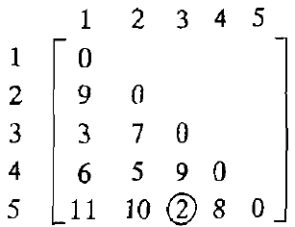
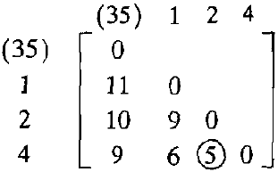
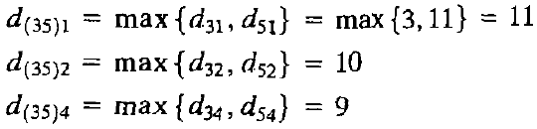
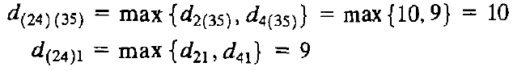
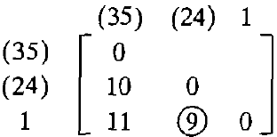
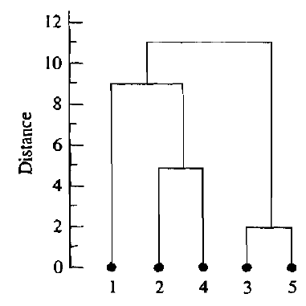
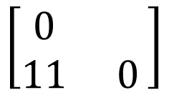
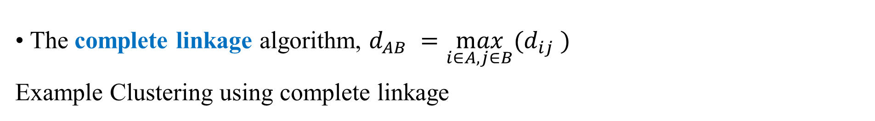
• The complete linkage algorithm, $d_{AB} =\max_{i∈A,j∈B}{(d_{ij} )}$
Example Clustering using complete linkage
(35) (124)
$$\left[\begin{matrix}0 & \\ 11 & 0\end{matrix}\right]$$

Slide 25
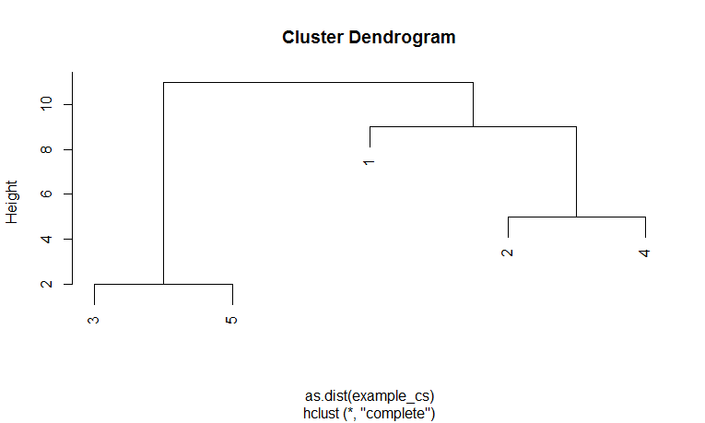
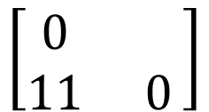
• The complete linkage algorithm:
plot(cs <- hclust(as.dist(example_cs), method = "complete"))
(35) (124)
$$\left[\begin{matrix}0 & \\ 11 & 0\end{matrix}\right]$$

Slide 26
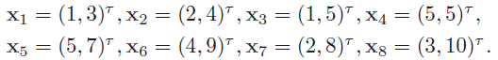
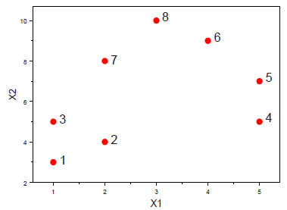
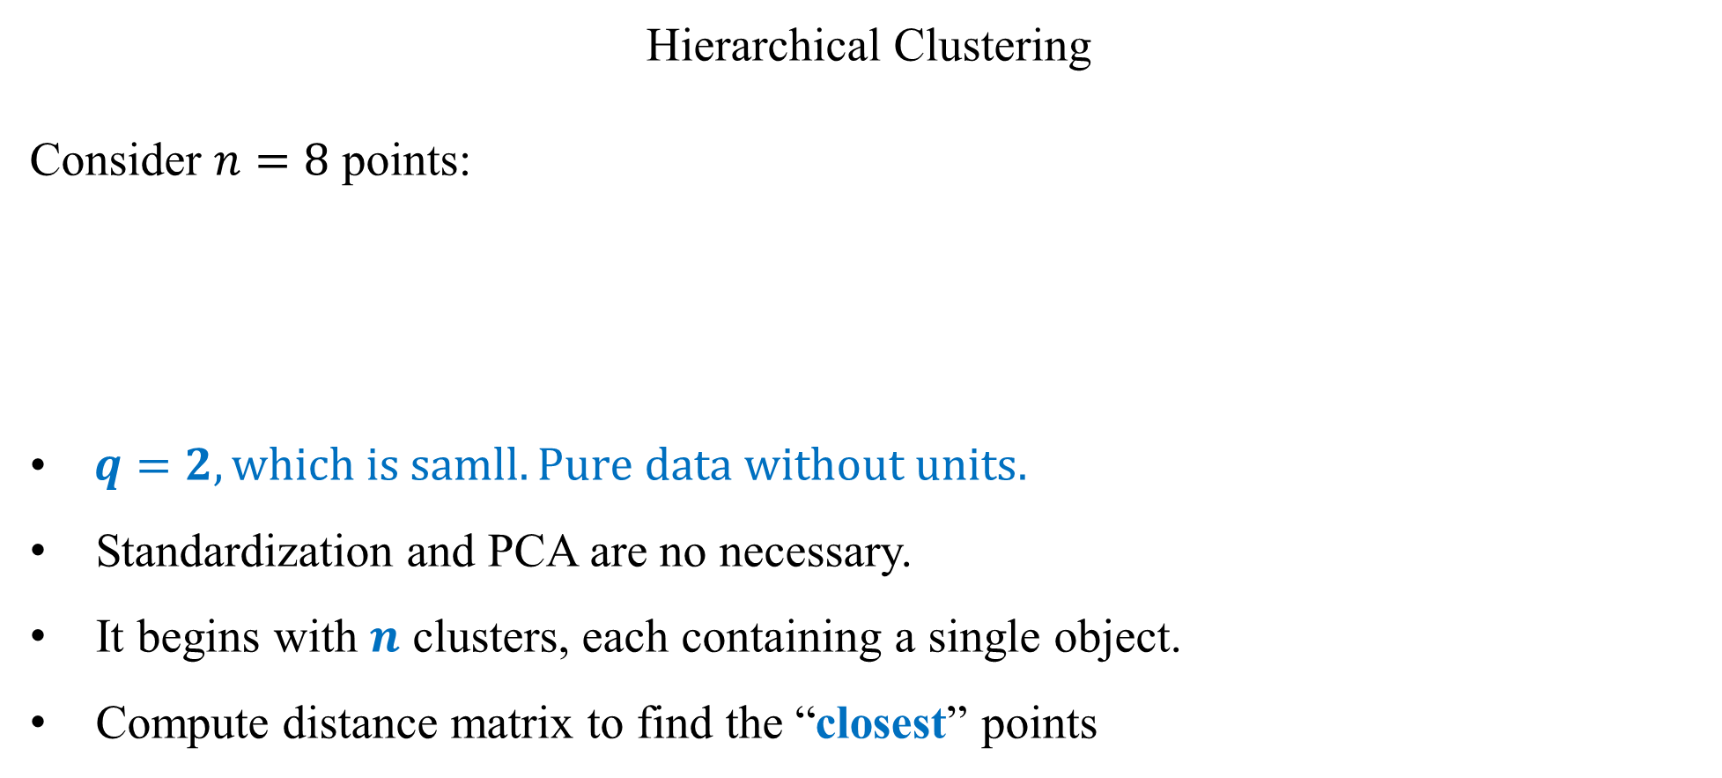
Hierarchical Clustering
Consider $n=8$ points:
• $q=2, which is samll. Pure data without units.$
Standardization and PCA are no necessary.
It begins with $n$ clusters, each containing a single object.
Compute distance matrix to find the “closest” points

Slide 27
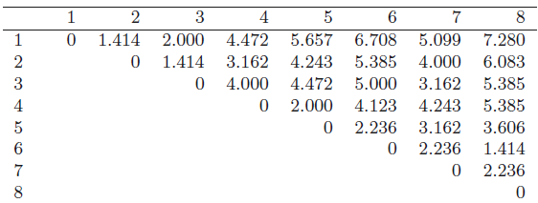
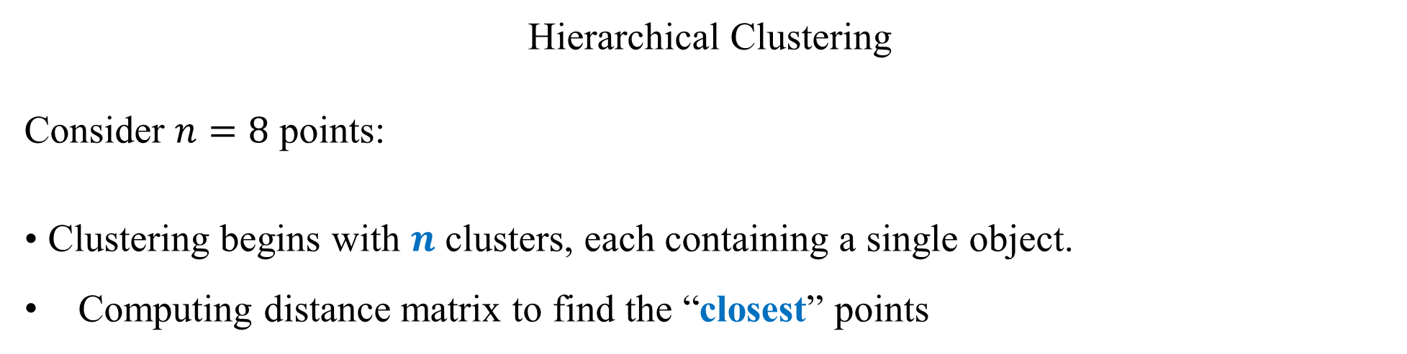
Hierarchical Clustering
Consider $n=8$ points:
• Clustering begins with $n$ clusters, each containing a single object.
Computing distance matrix to find the “closest” points

Slide 28
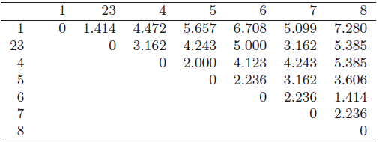

Hierarchical Clustering
• Clustering begins with $n$ clusters, each containing a single object.
Computing distance matrix to find the “closest” points
The smallest dissimilarity is $d_{12} = d_{23} = d_{68} = 1.414$. We choose to merge $x_{2}$ and $x_{3}$ to form the new cluster “23.”

Slide 29


Hierarchical Clustering
• Clustering begins with $n$ clusters, each containing a single object.
Computing distance matrix to find the “closest” points
The smallest dissimilarity is $d_{12} = d_{23} = d_{68} = 1.414$. We choose to merge $x_{1}$ and ${(x}_{2}$, $x_{3})$ to form the new cluster “123.”
So as the steps iterate, there are $n$ clusters, then $n − 1$clusters, then $n − 2$, etc.

Slide 30


Hierarchical Clustering
Consider $n=8$ points:
• Clustering begins with $n$ clusters, each containing a single object.
Computing distance matrix to find the “closest” points
The smallest dissimilarity is $d_{45} =2$

Slide 31




Hierarchical Clustering
Consider $n=8$ points:
• Clustering begins with $n$ clusters, each containing a single object.
Computing distance matrix to find the “closest” points
The smallest dissimilarity is $d_{(68)(7)} =2.236, {\text{merge} c_{68} \text{and} c_{7} \text{to} \text{form} \text{the} \text{new} \text{cluster}\text{ “678" };d}_{(678)(45)} =2.236$. We choose to merge to form the new cluster “45678.”
etc.
The last merge is cluster “123” with cluster “45678,” and the merging dissimilarity is
$$d_{123,45678}= 3.162.$$

Slide 32

Dendrograms
• A hierarchical algorithm actually produces a clustering partition for each step 1, 2, . . ., n.
• The series of merging can be represented at a glance by a tree like structure called a dendrogram.
• To get a single $k$-cluster solution, we would cut the dendrogram horizontally at a point that would produce $k$ groups (The R function cutree can do this).
• It is strongly recommended to examine the full dendrogram first before determining where to cut it.
• A natural set of clusters may be apparent from a glance at the dendrogram.

Slide 33






Hierarchical Clustering
$$d_{123}= d_{68} =1.414$$
$$d_{45}=2$$

Slide 34


Hierarchical Clustering
$$d_{123}= d_{68} =1.414$$

Slide 36



library("MVA")
bipts<-read.csv("D:/Spring-2017/MATH 4400/Data/bipts.csv", head=FALSE)
(d<-dist(bipts))
plot(cs <- hclust(d, method = "single"))
plot(cc <- hclust(d, method = "complete"))
plot(ca <- hclust(d, method = "average"))

Slide 37

Hierarchical Clustering for data measure ($q=5, n=20$)
library("MVA")
measure<-read.csv("D:/STAT 4400/Data/measure.csv", header=TRUE)

Slide 38



Hierarchical Clustering for data measure ($q=5, n=20$)
(dm<-dist(measure[, c("chest", "waist", "hips")]))
plot(cs <- hclust(dm, method = "single"))
plot(cc <- hclust(dm, method = "complete"))
plot(ca <- hclust(dm, method = "average"))

Slide 39


body_pc <- princomp(dm, cor = TRUE)
plot(body_pc$scores[,1:2], type = "n")
lab <- cutree(cs, h = 3.7) #lab<-cutree(cs, k=2)
text(body_pc$scores[,1:2], labels = lab, cex = 0.6)
Two-group solution of cluster analysis

Slide 40

body_pc <- princomp(dm, cor = TRUE)
plot(body_pc$scores[,1:2], type = "n")
lab <- cutree(cc, h = 10)
text(body_pc$scores[,1:2], labels = lab, cex = 0.6)
Two-group solution of cluster analysis

Slide 41

body_pc <- princomp(dm, cor = TRUE)
plot(body_pc$scores[,1:2], type = "n")
lab <- cutree(cc, h = 7.8)
text(body_pc$scores[,1:2], labels = lab, cex = 0.6)
Two-group solution of cluster analysis

Slide 42
Example Data collected on 22 U.S. public utility companies are listed in Table. Although it is interesting to group companies, we are more interesting to group the eight variables.
Company | X1 | X2 | X3 | X4 | X5 | X6 | X7 | X8
Arizona | 1.06 | 9.2 | 151 | 54.4 | 1.6 | 9077 | 0 | 0.628
Boston | 0.89 | 10.3 | 202 | 57.9 | 2.2 | 5088 | 25.3 | 1.555
Central | 1.43 | 15.4 | 113 | 53 | 3.4 | 9212 | 0 | 1.058
Common | 1.02 | 11.2 | 168 | 56 | 0.3 | 6423 | 34.3 | 0.7
Consolid | 1.49 | 8.8 | 192 | 51.2 | 1 | 3300 | 15.6 | 2.044
Florida | 1.32 | 13.5 | 111 | 60 | -2.2 | 11127 | 22.5 | 1.241
Hawaiian | 1.22 | 12.2 | 175 | 67.6 | 2.2 | 7642 | 0 | 1.652
Idaho | 1.1 | 9.2 | 245 | 57 | 3.3 | 13082 | 0 | 0.309
Kentucky | 1.34 | 13 | 168 | 60.4 | 7.2 | 8406 | 0 | 0.862
Madison | 1.12 | 12.4 | 197 | 53 | 2.7 | 6455 | 39.2 | 0.623
Nevada | 0.75 | 7.5 | 173 | 51.5 | 6.5 | 17441 | 0 | 0.768
NewEngla | 1.13 | 10.9 | 178 | 62 | 3.7 | 6154 | 0 | 1.897
Northern | 1.15 | 12.7 | 199 | 53.7 | 6.4 | 7179 | 50.2 | 0.527
Oklahoma | 1.09 | 12 | 96 | 49.8 | 1.4 | 9673 | 0 | 0.588
Pacific | 0.96 | 7.6 | 164 | 62.2 | -0.1 | 6468 | 0.9 | 1.4
Puget | 1.16 | 9.9 | 252 | 56 | 9.2 | 15991 | 0 | 0.62
SanDiego | 0.76 | 6.4 | 136 | 61.9 | 9 | 5714 | 8.3 | 1.92
Southern | 1.05 | 12.6 | 150 | 56.7 | 2.7 | 10140 | 0 | 1.108
Texas | 1.16 | 11.7 | 104 | 54 | -2.1 | 13507 | 0 | 0.636
Wisconsi | 1.2 | 11.8 | 148 | 59.9 | 3.5 | 7287 | 41.1 | 0.702
United | 1.04 | 8.6 | 204 | 61 | 3.5 | 6650 | 0 | 2.116
Virginia | 1.07 | 9.3 | 174 | 54.3 | 5.9 | 10093 | 26.6 | 1.306
X1: Fixed-charge coverage ratio (income/debt)
X2: rate of return on capital
X3: cost per KW capacity in place
X4: Annual load factor
X5: Peak kWh demand growth from 1974-1975
X6: Sales (kWh use per year)
X7: Percent nuclear
X8: Total fuel costs (cents per kWh)

Slide 43
We are more interesting to group the eight variables.
Company | X1 | X2 | X3 | X4 | X5 | X6 | X7 | X8
Arizona | 1.06 | 9.2 | 151 | 54.4 | 1.6 | 9077 | 0 | 0.628
Boston | 0.89 | 10.3 | 202 | 57.9 | 2.2 | 5088 | 25.3 | 1.555
Central | 1.43 | 15.4 | 113 | 53 | 3.4 | 9212 | 0 | 1.058
Common | 1.02 | 11.2 | 168 | 56 | 0.3 | 6423 | 34.3 | 0.7
Consolid | 1.49 | 8.8 | 192 | 51.2 | 1 | 3300 | 15.6 | 2.044
Florida | 1.32 | 13.5 | 111 | 60 | -2.2 | 11127 | 22.5 | 1.241
Hawaiian | 1.22 | 12.2 | 175 | 67.6 | 2.2 | 7642 | 0 | 1.652
Idaho | 1.1 | 9.2 | 245 | 57 | 3.3 | 13082 | 0 | 0.309
Kentucky | 1.34 | 13 | 168 | 60.4 | 7.2 | 8406 | 0 | 0.862
Madison | 1.12 | 12.4 | 197 | 53 | 2.7 | 6455 | 39.2 | 0.623
Nevada | 0.75 | 7.5 | 173 | 51.5 | 6.5 | 17441 | 0 | 0.768
NewEngla | 1.13 | 10.9 | 178 | 62 | 3.7 | 6154 | 0 | 1.897
Northern | 1.15 | 12.7 | 199 | 53.7 | 6.4 | 7179 | 50.2 | 0.527
Oklahoma | 1.09 | 12 | 96 | 49.8 | 1.4 | 9673 | 0 | 0.588
Pacific | 0.96 | 7.6 | 164 | 62.2 | -0.1 | 6468 | 0.9 | 1.4
Puget | 1.16 | 9.9 | 252 | 56 | 9.2 | 15991 | 0 | 0.62
SanDiego | 0.76 | 6.4 | 136 | 61.9 | 9 | 5714 | 8.3 | 1.92
Southern | 1.05 | 12.6 | 150 | 56.7 | 2.7 | 10140 | 0 | 1.108
Texas | 1.16 | 11.7 | 104 | 54 | -2.1 | 13507 | 0 | 0.636
Wisconsi | 1.2 | 11.8 | 148 | 59.9 | 3.5 | 7287 | 41.1 | 0.702
United | 1.04 | 8.6 | 204 | 61 | 3.5 | 6650 | 0 | 2.116
Virginia | 1.07 | 9.3 | 174 | 54.3 | 5.9 | 10093 | 26.6 | 1.306
X1: Fixed-charge coverage ratio (income/debt)
X2: rate of return on capital
X3: cost per KW capacity in place
X4: Annual load factor
X5: Peak kWh demand growth from 1974-1975
X6: Sales (kWh use per year)
X7: Percent nuclear
X8: Total fuel costs (cents per kWh)
What is an appropriate parameter to describe the dissimilarity of the eight variables?

Slide 44
What is an appropriate parameter to describe the dissimilarity of the eight variables?
X1: Fixed-charge coverage ratio (income/debt)
X2: rate of return on capital
X3: cost per KW capacity in place
X4: Annual load factor
X5: Peak kWh demand growth from 1974-1975
X6: Sales (kWh use per year)
X7: Percent nuclear
X8: Total fuel costs (cents per kWh)
We measure the similarity between pairs of variables by correlation coefficient.
Company | X1 | X2 | X3 | X4 | X5 | X6 | X7 | X8
Arizona | 1.06 | 9.2 | 151 | 54.4 | 1.6 | 9077 | 0 | 0.628
Boston | 0.89 | 10.3 | 202 | 57.9 | 2.2 | 5088 | 25.3 | 1.555
Central | 1.43 | 15.4 | 113 | 53 | 3.4 | 9212 | 0 | 1.058
Common | 1.02 | 11.2 | 168 | 56 | 0.3 | 6423 | 34.3 | 0.7
Consolid | 1.49 | 8.8 | 192 | 51.2 | 1 | 3300 | 15.6 | 2.044
Florida | 1.32 | 13.5 | 111 | 60 | -2.2 | 11127 | 22.5 | 1.241
Hawaiian | 1.22 | 12.2 | 175 | 67.6 | 2.2 | 7642 | 0 | 1.652
Idaho | 1.1 | 9.2 | 245 | 57 | 3.3 | 13082 | 0 | 0.309
Kentucky | 1.34 | 13 | 168 | 60.4 | 7.2 | 8406 | 0 | 0.862
Madison | 1.12 | 12.4 | 197 | 53 | 2.7 | 6455 | 39.2 | 0.623
Nevada | 0.75 | 7.5 | 173 | 51.5 | 6.5 | 17441 | 0 | 0.768
NewEngla | 1.13 | 10.9 | 178 | 62 | 3.7 | 6154 | 0 | 1.897
Northern | 1.15 | 12.7 | 199 | 53.7 | 6.4 | 7179 | 50.2 | 0.527
Oklahoma | 1.09 | 12 | 96 | 49.8 | 1.4 | 9673 | 0 | 0.588
Pacific | 0.96 | 7.6 | 164 | 62.2 | -0.1 | 6468 | 0.9 | 1.4
Puget | 1.16 | 9.9 | 252 | 56 | 9.2 | 15991 | 0 | 0.62
SanDiego | 0.76 | 6.4 | 136 | 61.9 | 9 | 5714 | 8.3 | 1.92
Southern | 1.05 | 12.6 | 150 | 56.7 | 2.7 | 10140 | 0 | 1.108
Texas | 1.16 | 11.7 | 104 | 54 | -2.1 | 13507 | 0 | 0.636
Wisconsi | 1.2 | 11.8 | 148 | 59.9 | 3.5 | 7287 | 41.1 | 0.702
United | 1.04 | 8.6 | 204 | 61 | 3.5 | 6650 | 0 | 2.116
Virginia | 1.07 | 9.3 | 174 | 54.3 | 5.9 | 10093 | 26.6 | 1.306

Slide 45
What is an appropriate parameter to describe the dissimilarity of the eight variables?
We measure the similarity between pairs of variables by correlation coefficient.
When the sample correlations are used as similarity measures, variables with large negative correlations are regarded as very dissimilar; variables with large positive correlations are regarded as very similar. In this case, the “distance” between clusters is measured as the smallest similarity between members of the corresponding cluster.
Company | X1 | X2 | X3 | X4 | X5 | X6 | X7 | X8
Arizona | 1.06 | 9.2 | 151 | 54.4 | 1.6 | 9077 | 0 | 0.628
Boston | 0.89 | 10.3 | 202 | 57.9 | 2.2 | 5088 | 25.3 | 1.555
Central | 1.43 | 15.4 | 113 | 53 | 3.4 | 9212 | 0 | 1.058
Common | 1.02 | 11.2 | 168 | 56 | 0.3 | 6423 | 34.3 | 0.7
Consolid | 1.49 | 8.8 | 192 | 51.2 | 1 | 3300 | 15.6 | 2.044
Florida | 1.32 | 13.5 | 111 | 60 | -2.2 | 11127 | 22.5 | 1.241
Hawaiian | 1.22 | 12.2 | 175 | 67.6 | 2.2 | 7642 | 0 | 1.652
Idaho | 1.1 | 9.2 | 245 | 57 | 3.3 | 13082 | 0 | 0.309
Kentucky | 1.34 | 13 | 168 | 60.4 | 7.2 | 8406 | 0 | 0.862
Madison | 1.12 | 12.4 | 197 | 53 | 2.7 | 6455 | 39.2 | 0.623
Nevada | 0.75 | 7.5 | 173 | 51.5 | 6.5 | 17441 | 0 | 0.768
NewEngla | 1.13 | 10.9 | 178 | 62 | 3.7 | 6154 | 0 | 1.897
Northern | 1.15 | 12.7 | 199 | 53.7 | 6.4 | 7179 | 50.2 | 0.527
Oklahoma | 1.09 | 12 | 96 | 49.8 | 1.4 | 9673 | 0 | 0.588
Pacific | 0.96 | 7.6 | 164 | 62.2 | -0.1 | 6468 | 0.9 | 1.4
Puget | 1.16 | 9.9 | 252 | 56 | 9.2 | 15991 | 0 | 0.62
SanDiego | 0.76 | 6.4 | 136 | 61.9 | 9 | 5714 | 8.3 | 1.92
Southern | 1.05 | 12.6 | 150 | 56.7 | 2.7 | 10140 | 0 | 1.108
Texas | 1.16 | 11.7 | 104 | 54 | -2.1 | 13507 | 0 | 0.636
Wisconsi | 1.2 | 11.8 | 148 | 59.9 | 3.5 | 7287 | 41.1 | 0.702
United | 1.04 | 8.6 | 204 | 61 | 3.5 | 6650 | 0 | 2.116
Virginia | 1.07 | 9.3 | 174 | 54.3 | 5.9 | 10093 | 26.6 | 1.306

Slide 46

library("MVA")
utility<-read.csv("D:/STAT 4400/Data/Utility.csv", row.names=1, head=TRUE)
cor<-round(cor(utility),3)

Slide 47

dm<-as.dist(cor)
plot(cc<-hclust(dm,method="complete"))
Is the result correct?

Slide 48

 | X(12) | X3 | X4 | X5 | X6 | X7
X(12) | 0
X3 | -0.348 | 0
X4 | -0.086 | 0.1 | 0
X5 | -0.26 | 0.435 | 0.033 | 0
X6 | -0.152 | 0.028 | -0.288 | 0.176 | 0
X7 | 0.045 | 0.115 | -0.164 | -0.019 | -0.374 | 0
X8 | -0.328 | 0.005 | 0.486 | -0.007 | -0.561 | -0.186
 | X(12) | X3 | X(48) | X5 | X6 | X7
X(12) | 0
X3 | -0.348 | 0
X(48) | -0.328 | 0.005 | 0
X5 | -0.26 | 0.435 | -0.007 | 0
X6 | -0.152 | 0.028 | -0.561 | 0.176 | 0
X7 | 0.045 | 0.115 | -0.186 | -0.019 | -0.374 | 0
 | X(12) | X(35) | X(48) | X6 | X7
X(12) | 0
X(35) | -0.348 | 0
X(48) | -0.328 | -0.007 | 0
X6 | -0.152 | 0.028 | -0.561 | 0
X7 | 0.045 | -0.019 | -0.186 | -0.374 | 0
 | X(127) | X(35) | X(48) | X6
X(127) | 0
X(35) | -0.348 | 0
X(48) | -0.328 | -0.007 | 0
X6 | -0.374 | 0.028 | -0.561 | 0
 | X(127) | X(356) | X(48)
X(127) | 0
X(356) | -0.374 | 0
X(48) | -0.328 | -0.561 | 0
 | X(127)(48) | X(356)
X(127)(48) | 0
X(356) | -0.561 | 0

Slide 49

 | X(12) | X3 | X4 | X5 | X6 | X7
X(12) | 0
X3 | -0.348 | 0
X4 | -0.086 | 0.1 | 0
X5 | -0.26 | 0.435 | 0.033 | 0
X6 | -0.152 | 0.028 | -0.288 | 0.176 | 0
X7 | 0.045 | 0.115 | -0.164 | -0.019 | -0.374 | 0
X8 | -0.328 | 0.005 | 0.486 | -0.007 | -0.561 | -0.186
 | X(12) | X3 | X(48) | X5 | X6 | X7
X(12) | 0
X3 | -0.348 | 0
X(48) | -0.328 | 0.005 | 0
X5 | -0.26 | 0.435 | -0.007 | 0
X6 | -0.152 | 0.028 | -0.561 | 0.176 | 0
X7 | 0.045 | 0.115 | -0.186 | -0.019 | -0.374 | 0
 | X(12) | X(35) | X(48) | X6 | X7
X(12) | 0
X(35) | -0.348 | 0
X(48) | -0.328 | -0.007 | 0
X6 | -0.152 | 0.028 | -0.561 | 0
X7 | 0.045 | -0.019 | -0.186 | -0.374 | 0
 | X(127) | X(35) | X(48) | X6
X(127) | 0
X(35) | -0.348 | 0
X(48) | -0.328 | -0.007 | 0
X6 | -0.374 | 0.028 | -0.561 | 0
 | X(127) | X(356) | X(48)
X(127) | 0
X(356) | -0.374 | 0
X(48) | -0.328 | -0.561 | 0
 | X(127)(48) | X(356)
X(127)(48) | 0
X(356) | -0.561 | 0

Slide 50



library("MVA")
utility<-read.csv("D:/STAT 4400/Data/Utility.csv", row.names=1, head=TRUE)
cor<-round(cor(utility),3)
i<=1
a<-matrix(c(i/10), nrow=8, ncol=8)
dm<-as.dist(a-cor)
plot(cc<-hclust(dm,method="complete"))
Height$=1−r_{ij}$, which is not describe the similarity or dissimilarity.
Compare the height with similarity

Slide 51

> jet<-read.csv("D:/Spring-2017/MATH 4400/Data/jet data.csv",row.names = 1, head=TRUE)
> x<- scale(jet[, c("SPR", "RGF", "PLF", "SLF")], center = FALSE)
> dj <- dist(x)
> plot(cc <- hclust(dj), main = "Jets clustering")
> cc
Call:
hclust(d = dj)
Cluster method : complete
Distance : Euclidean
Number of objects: 22

Slide 52
The resulting dendrogram strongly suggests the presence of two groups of fighters.

Slide 53

The data are plotted in the space of the first two principal components. And in Figure 6.6 the points are labelled by cluster number for the two-group solution and the colors used are the values of the CAR variable. The two-group solution largely corresponds to planes that can and cannot land on a carrier.

Slide 54

pr<- prcomp(dj)$x[, 1:2]
plot(pr, pch = (1:2)[cutree(cc, k = 2)],col = c("black", “blue")[jet$CAR])
legend("topright", col = c("black", "black",“blue", “blue"),legend = c("1 / no", "2 / no", "1 / yes", "2 / yes"),pch = c(1:2, 1:2), title = "Cluster / CAR", bty = "n")

Slide 55

Pros and Cons of Hierarchical Clustering
• An advantage is that the dendrogram gives a picture of the clustering solution for a variety of choices of $k$ (the number of clusters) at once.
• A major disadvantage is that once two clusters have been joined, they can never be split apart later in the algorithm, even if such a move would improve the clustering.
• The partitioning methods of cluster analysis do not have this restriction.
• In addition, hierarchical methods can be less efficient than partitioning methods for large data sets, when $n$ is much greater than $k$.

Slide 56





Partitioning Methods: K-Means
Number of clusters $k$ is fixed in advance. Find $k$ cluster centers $\overline{x}$ and assignments, within-groups Sum of Squares (WGSS) is minimal.
In the traditional K-means approach, “closeness” to the cluster centers is to minimize the sum, defined by: where $x = {\left(x_{1}, . . . , x_{q}\right)}^{T}$is any particular observation and ${\overline{x}}_{c}$ is the centroid (multivariate mean vector) for cluster c.
The goal is to minimize the sum (over all objects within all clusters) of these squared Euclidean distances:
$d_{E}^{2}(x, {\overline{x}}_{c})$=

Slide 57




The K-means Algorithm
• The K-means algorithm begins by randomly allocating the $n$objects into $k$ clusters, or randomly specifying $k$ centroids.
• One at a time, the algorithm moves centroid is closest to it, using the measure of closeness $d_{E}^{2}(x, {\overline{x}}_{c})$
• When an object is moved, the centroids are immediately recalculated for the cluster gaining the object and the cluster losing it.
• The method repeatedly cycles though the objects until no reassignments of objects take place. • The final clustering result will somewhat depend on the initial configuration of the objects.
K=3

Slide 58




Slide 59


Slide 60


Slide 61


Slide 62




Slide 63






Example (Clustering using the k-means method) Suppose we measure two variables X1 and X2 for each of four items A, B, C, and D. Divide these items into $k=2$.
The k-means algorithm begins by randomly allocating the $4$objects into $2$ clusters, or randomly specifying $2$ centroids.
The center of (AB) is $(2, 2),$the center of (CD) is $(−1, −2)$
The algorithm moves centroid is closest to it, using the measure of closeness $d_{E}^{2}\left(x, {\overline{x}}_{c}\right)$
If A is not moved:
If A is moved to the (CD), the center of (ACD) is $(1, −.33)$
Since A is closer to the center of (AB) than it to the center of (ACD), it is not reassigned.

Slide 64





The k-means algorithm begins by randomly allocating the $4$objects into $2$ clusters, or randomly specifying $2$ centroids.
The center of (AB) is $(2, 2),$the center of (CD) is $(−1, −2)$
The algorithm moves centroid is closest to it, using the measure of closeness $d_{E}^{2}\left(x, {\overline{x}}_{c}\right)$
If A is not moved:
If A is moved to the (CD), the center of (ACD) is $(1, −.33)$
Since A is closer to the center of (AB) than it to the center of (ACD), it is not reassigned.
Continuing, we consider reassigning B.
If B is not moved:
If B is moved to the (CD), the center of (BCD) is $(−1, −1)$
Since B is closer to the center of (BCD) than it to the center of (AB), B is reassigned.

Slide 65



The k-means algorithm begins by randomly allocating the $4$objects into $2$ clusters, or randomly specifying $2$ centroids.
The center of (AB) is $(2, 2),$the center of (CD) is $(−1, −2)$
We check C for reassignment
If C is not moved:
If C is moved to the (A), the center of (AC) is $(3, .5)$
Since C is closer to the center of (BCD) than it to the center of (AC), C is not reassigned.
Continuing in this way, we find that no more reassignments take place and the find k=2 clusters and (A) and (BCD).

Slide 66




Minimize the sum
Initial partition (AB) and (CD)
To check the stability of the clustering, it is desirable to rerun the algorithm with a new initial partition.

Slide 67
Once clusters are determined, intuitions concerning their interpretations are aided by rearranging the list of items so that those in the first cluster appear first, those in the second cluster appear next, and so forth. A table of the cluster centroids and within-cluster variances also helps to delineate group differences.

Slide 68





The center of (A): $(5, 3)$
The center (BCD): $(\frac{−1+1−3}{3}=−1, \frac{1−2−2}{3}=−1)$
library("MVA")
data<-matrix(c(5, 3, -1, 1, 1, -2, -3, -2), nrow=4, ncol=2, byrow=1)
(cluster<-kmeans(data, centers = 2))
Center (A): (5,3); Center (BCD): (-1,-1)
Cluster 1 (A); Cluster 2( BCD)
$$d_{A}^{2}=0, d_{BCD}^{2}=14$$
$$\frac{b_{ss}}{t_{ss}}=1−\frac{withinss}{sum of squares to the globaal sample mean}$$

Slide 69

library("MVA") data<-matrix(c(5, 3, -1, 1, 1, -2, -3, -2), nrow=4, ncol=2, byrow=1) n<-nrow(data) wss<-rep(0,4) for (i in 1:3) wss[i]<-sum(kmeans(data,centers=i)$withinss) plot(1:4,wss, type="b", xlab="number of groups",ylab="within groups sum of squares")

Slide 70

Example Clustering the states of the USA on the basis of their crime rate profiles
The Statistical Abstract of the USA gives rates of deferent types of crime per 100,000 residents of the 50 states of the USA plus the D.C. The data are given in Table.
$$n=50, q=7$$

Slide 71

Example Clustering the states of the USA on the basis of their crime rate profiles
$$n=50, q=7$$
Examine the data by
Drawing a scatter plot (R: pairs)
Identifying outliers (R: subset(crime, Murder>15)
Computing the dispersions (R: sapply(crime,var))

Slide 72

Potential outlier in variable murder
The plot suggests that at least one of the cities is considerably different from the others.
Identify using
subset(crime, Murder > 15)
Murder Rape Robbery Assault Burglary Theft Vehicle
DC 31 52.4 754 668 1728 4131 975

Slide 73


Remove outlier in variable murder
library("MVA")
crime<-read.csv(“full path /crime.csv", row.names=1, header=TRUE)
pairs(crime)
subset(crime,Murder>15)
crime_rem<-crime[-24,]
pairs(crime_rem)

Slide 74

Remove outlier in variable murder
The variances are very different, and using k-means on the raw data would not
be sensible; we must standardize the data in some way, and here we standardize
each variable by its range.

Slide 75

Remove outlier in variable murder
The variances of the standardized data are very similar for all variables, and we can now progress with clustering the data.
Determine $k$: First we plot the within-groups sum of squares for one- to six-group solutions to see if we can get any indication of the number of groups.

Slide 76

Remove outlier in variable murder
Determine $k$: First we plot the within-groups sum of squares for one- to six-group solutions to see if we can get any indication of the number of groups.
for (i in 1:6)
wss[i]<-sum(kmeans(crime_s,centers=i)$withinss)
plot(1:6,wss, type="b", xlab="number of groups",ylab="within groups sum of squares")

Slide 77


$K$-Means: Number of clusters
• Run $k$-Means for several number of groups
• Plot WGSS vs. number of groups
• Choose number of groups after the last big drop off

Slide 78

(cluster<-kmeans(crime_s,centers=3))

